Slide 1

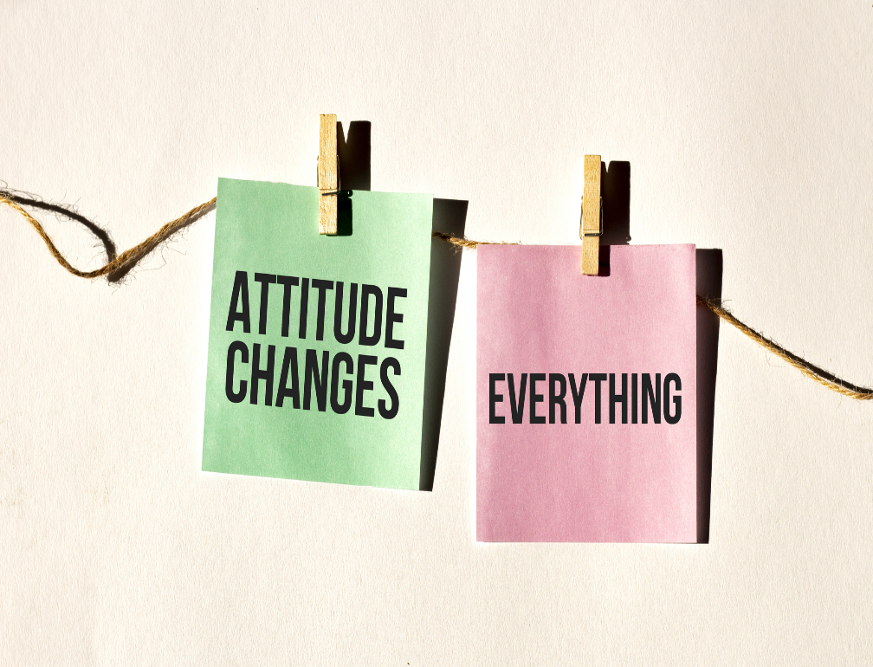

Attitude Measurement

Slide 2
NON- COMPARATIVE SCALES
One of the two types of scaling techniques in which each stimulus object is scaled independently of the other object in the stimulus set

Slide 3
TYPES OF NON- COMPARATIVE SCALES
Continuous rating scales
Itemized rating scales
  Likert scale
  Semantic differential scale
  Thurstone scale

Slide 4
Graphic Rating Scales: Graphic ratings scales include a graphic continuum anchored between two extremes.

Slide 5
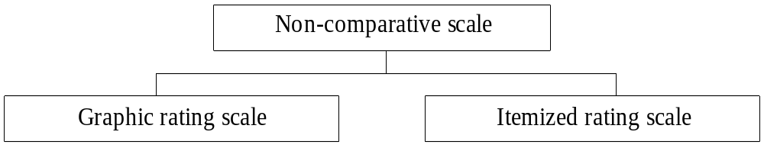

Classification of Scales
Graphic Rating Scale – This is a continuous scale and the respondent is asked to tick his preference on a graph.
Examples:

Slide 6
Continuous Rating Scale
Respondents rate the objects by placing a mark at the appropriate position on a line that runs from one extreme of the criterion variable to the other. The form of the continuous scale may vary considerably.
How would you rate More as a department store?
Version 1
Probably the worst - - - - - - -I - - - - - - - - - - - - - - - - - - - - - - - - - - - - - - - - - - - - - - Probably the best
Version 2
Probably the worst - - - - - - -I - - - - - - - - - - - - - - - - - - - - - - - - - - - - - - - - - - - -- - Probably the best
0 10 20 30 40 50 60 70 80 90 100
Version 3
Very bad Neither good Very good
nor bad
Probably the worst - - - - - - -I - - - - - - - - - - - - - - - - - - - - - -- - - - - - - - - - - - - - - - -Probably the best
0 10 20 30 40 50 60 70 80 90 100

Slide 7
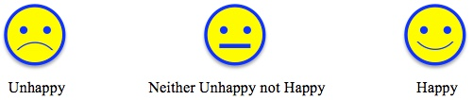
Eating a Happy Meal at McDonald's make me feel

Slide 8
Itemized Category Scale
The itemized rating scale is, perhaps, the most frequently used in marketing research because of its simplicity and adaptability
to most measurement situations.

Slide 9
Semantic Differential Scale
A unique bipolar ordinal scale format that captures a person’s attitudes or feelings about a given object.
This type of scale is unique in its use of bipolar adjectives and adverbs (good/bad, like/dislike, competitive/noncompetitive, helpful/unhelpful, etc.)

Slide 10
Semantic Differential Scale
      Reliance Fresh is:
      Powerful --:--:--:--:-X-:--:--: Weak
      Unreliable --:--:--:--:--:-X-:--: Reliable
      Modern --:--:--:--:--:--:-X-: Old-fashioned

Slide 11
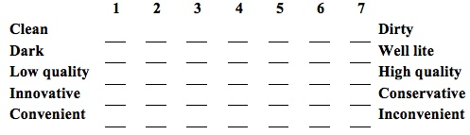
Below is a list of characteristics of Kmart stores. For each pair of adjectives, place an "X" at the point that you believe best reflects your experience at Hypermarket.

Slide 12
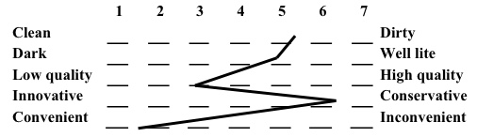
Semantic Differential Scale Summary Chart

Slide 13
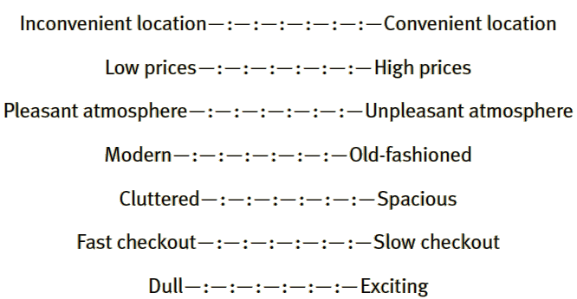
Semantic Differential Scales for Measuring Attitudes Toward Supermarkets

Slide 14
Attitude Rating Scales
    A weight is assigned to each position on the scale. Traditionally, scores are 7, 6, 5, 4, 3, 2, 1, or +3, +2, +1, 0, -1, -2, -3.
Exciting ___ : ___ : ___ : ___ : ___ : ___ : ___ Calm
Interesting ___ : ___ : ___ : ___ : ___ : ___ : ___ Dull
Simple ___ : ___ : ___ : ___ : ___ : ___ : ___ Complex
Passive ___ : ___ : ___ : ___ : ___ : ___ : ___ Active

Slide 15
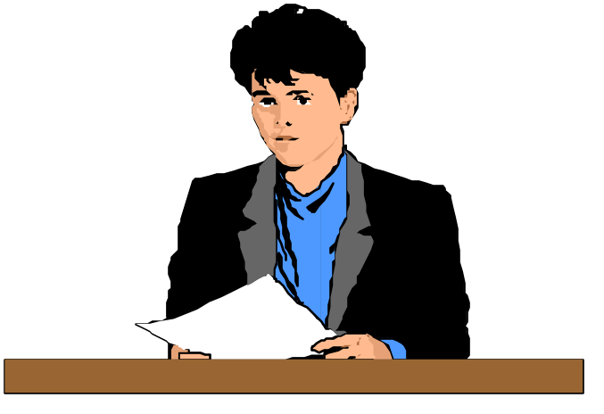
A Semantic Differential Scale for Measuring Self- Concepts, Person Concepts, and Product Concepts
1) Rugged :---:---:---:---:---:---:---: Delicate
2) Excitable :---:---:---:---:---:---:---: Calm
3) Uncomfortable :---:---:---:---:---:---:---: Comfortable
4) Dominating :---:---:---:---:---:---:---: Submissive
5) Thrifty :---:---:---:---:---:---:---: Indulgent
6) Pleasant :---:---:---:---:---:---:---: Unpleasant
7) Contemporary :---:---:---:---:---:---:---: Obsolete
8) Organized :---:---:---:---:---:---:---: Unorganized
9) Rational :---:---:---:---:---:---:---: Emotional
10) Youthful :---:---:---:---:---:---:---: Mature
11) Formal :---:---:---:---:---:---:---: Informal
12) Orthodox :---:---:---:---:---:---:---: Liberal
13) Complex :---:---:---:---:---:---:---: Simple
14) Colorless :---:---:---:---:---:---:---: Colorful
15) Modest :---:---:---:---:---:---:---: Vain

Slide 16
The seven scale positions are intended to signify:
Extremely x
Quite x
Slightly x
Neither x nor y; equally x and equally y
Slightly y
Quite y
Extremely y

Slide 17
This scale type is best for identifying a “perceptual image profile”
about the object or behavior of concern
Individual items on a semantic differential scale may be scored on either
+3 to - 3
Or 1 to 7 scale

Slide 18
Semantic differential scale format for Amitabh Bachchan as a credibility spokesperson for Maggie
EXPERTISE:
1 2 3 4 5 6 7
KNOWLEDGEABLE UNKNOWLEDGEABLE
EXPERT NOT AN EXPERT
SKILLED UNSKILLED
QUALIFIED UNQUALIFIED
EXPERIENCED INEXPERIENCED

Slide 19
TRUST WORTHINESS
1 2 3 4 5 6 7
RELIABLE UNRELIABLE
SINCERE INSINCERE
TRUSTWORTHY UNTRUSTWORTHY
DEPENDABLE UNDEPENDABLE
HONEST DISHONEST

Slide 20
ATTRACTIVENESS
1 2 3 4 5 6 7
BEAUTIFUL UGLY
ATTRACTIVE UNATTRACTIVE
CLASSY NOT CLASSY
ELEGANT PLAIN

Slide 21
Likert Scale
The Likert scale requires the respondents to indicate a degree of agreement or disagreement with each of a series of statements about the stimulus objects.
Strongly Disagree Neither Agree Strongly
disagree agree nor agree
disagree
1. Reliance sells high quality merchandise. 1 2X 3 4 5
2. Reliance has poor in-store service. 1 2X 3 4 5
3. I like to shop at Reliance. 1 2 3X 4 5

Slide 22

McDonald's Happy Meals are good value for the money.

Slide 23

After owning a Innova Crysta for three years, how likely are you to purchase a new Innova Crysta?

Slide 24
Non Comparative Scales
Evaluation of Globus—the Super Market by respondent
Sl. No. | Likert scale items | Strongly disagree | Disagree | Neither agree nor disagree | Agree | Strongly agree
1 | Salesmen at the shopping mall are courteous | - | - | - | - | -
2 | Shopping mall does not have enough parking space | - | - | - | - | -
3 | Prices of items are reasonable. | - | - | - | - | -
4 | Mall has wide range of products to choose | - | - | - | - | -
5 | Mall operating hours are inconvenient | - | - | - | - | -
6 | The arrangement of items in the mall is confusing | - | - | - | - | -

Slide 25
‘How important?’
Following your visit to the clinic today, please rate the following – first based on your experience and second how important this is to you?
 |  | 1 | 2 | 3 | 4 | 5 | 6 | 7
Waiting time | Very poor | □ | □ | □ | □ | □ | □ | □ | Excellent
How important is the length of waiting time to you? | Not important | □ | □ | □ | □ | □ | □ | □ | Very important
Quality of magazines in waiting room | Very poor | □ | □ | □ | □ | □ | □ | □ | Excellent
How important is the quality of magazines in waiting room to you? | Not important | □ | □ | □ | □ | □ | □ | □ | Very important
Notes:
Another point that it can be worth remembering is that whilst you are asking peoples opinions and how they rate different elements it can be just as important to ask them how important it is to them – to get a satisfaction rating.
This can be especially important if you are looking to make significant changes based on your findings. If it’s rated badly but it’s also not important to people then it doesn’t carry as much weight.
People might rate things poorly, but they might also not even have noticed it until you asked (!).
AHLee 2011

Slide 26
Stapel Scale
The Stapel scale is a unipolar rating scale with ten categories numbered from -5 to +5, without a neutral point (zero). This scale is usually presented vertically.
Reliance
+5 +5
+4 +4
+3 +3
+2 +2X
+1 +1
HIGH QUALITY POOR SERVICE
-1 -1
-2 -2
-3 -3
-4X -4
-5 -5
The data obtained by using a Stapel scale can be analyzed in the same way as semantic differential data.

Slide 27
Stapel Scale
Stapel scale
5
5
5
4
4
4
3
3
3
2
2
2
1
1
1
Accurate data
good
reasonable fee charged
–1
–1
–1
–2
–2
–2
–3
–3
–3
–4
–4
–4
–5
–5
–5
Stapel Scale is used in developing profile analysis. Despite the simplicity of constructing and usage, semantic differential scale finds an edge.
Cont….

Slide 28
Thurstone Scales:
Method of Equal-Appearing Intervals
They are used to measure the attitude towards a given concept or construct. For this purpose a large number of statements are collected that relate to the concept or construct being measured.

Slide 29
Example
To understand the attitude of employees in an organization towards diversity hiring in that organization
There are 2 distinct milestones in the Thurstone scale question; to derive the final questions and administer the Thurstone scale question and conduct its analysis

Slide 30
Step 1 – Develop statements

Slide 31
Develop a large number of agree/disagree statements on a certain topic. For example, if you wanted to find out people’s attitudes towards the policy of diversity hiring in an organization, your statements may include:
Policy on diversity hiring is wrong
Diversity hiring takes away jobs from deserving candidates
Diversity hiring brings different viewpoints to the team
Diversity hiring brings out the best in the local community
Diversity hiring aids in increasing the reputation of a brand

Slide 32
Step 2 – Rank each statement with a panel of judges
To have a panel of judges rate each item on a scale of 1 to 11 where 1 is the least favorable attitude towards the common vector – diversity hiring and 11 is an extremely favorable attitude
It is important to note that the judges are required to rate each option and not agree or disagree with them

Slide 33
Step 3 – Calculate median and/or mean and Interquartile range (IQR)
The data collected from all judges is to then be analyzed to draw up a table with the mean or median values in the ascending order.
Using median or mean is a personal choice and the options throw up accurate results in the use of either. If you have 50 statements, you need to have 50 means/medians and 50 IQR’s.

Slide 34
Step 4 – Sorting the table
The data has to be sorted on the basis of smallest to largest median/mean and the IQR’s for each median/mean have to be in a descending order. This can be represented as:

Slide 35
Table
Statement | Median or Mean | IQR
43 | 1 | 1.25
21 | 1 | 1
16 | 1.5 | 1
3 | 3 | 2
6 | 5 | 2
28 | 6 | 1
37 | 7 | 3
9 | 7.5 | 1.5
18 | 9 | 2
26 | 11 | 2

Slide 36
Step 5 – Selecting final variables or options
Select options on the basis of the above table. For example, select one item from each mean/median value.
For selecting the statements with the most agreement between judges. For each median value, select the item with the lowest interquartile range.

Slide 37
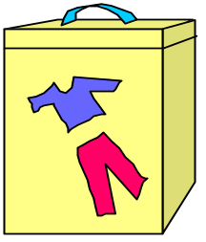
Rating Scale Configurations
A variety of scale configurations may be employed to measure the
gentleness of Cheer detergent. Some examples include:
Cheer detergent is:
1) Very harsh --- --- --- --- --- --- --- Very gentle
2) Very harsh 1 2 3 4 5 6 7 Very gentle
3) . Very harsh
.
.
. Neither harsh nor gentle
.
.
. Very gentle
4) ____ ____ ____ ____ ____ ____ ____
Very Harsh Somewhat Neither harsh Somewhat Gentle Very
harsh Harsh nor gentle gentle gentle
5)
Very Neither harsh Very
harsh nor gentle gentle
Cheer
-3
-2
-1
0
+1
+2
+3

Slide 38
Some Unique Rating Scale Configurations
Thermometer Scale
Instructions: Please indicate how much you like McDonald’s hamburgers by coloring in the thermometer. Start at the bottom and color up to the temperature level that best indicates how strong your preference is.
Form:
Smiling Face Scale
Instructions: Please point to the face that shows how much you like the Barbie Doll. If you do not like the Barbie Doll at all, you would point to Face 1. If you liked it very much, you would point to Face 5.
Form:
1 2 3 4 5
Like very much
100 75 50 25 0
Dislike very much

Slide 39
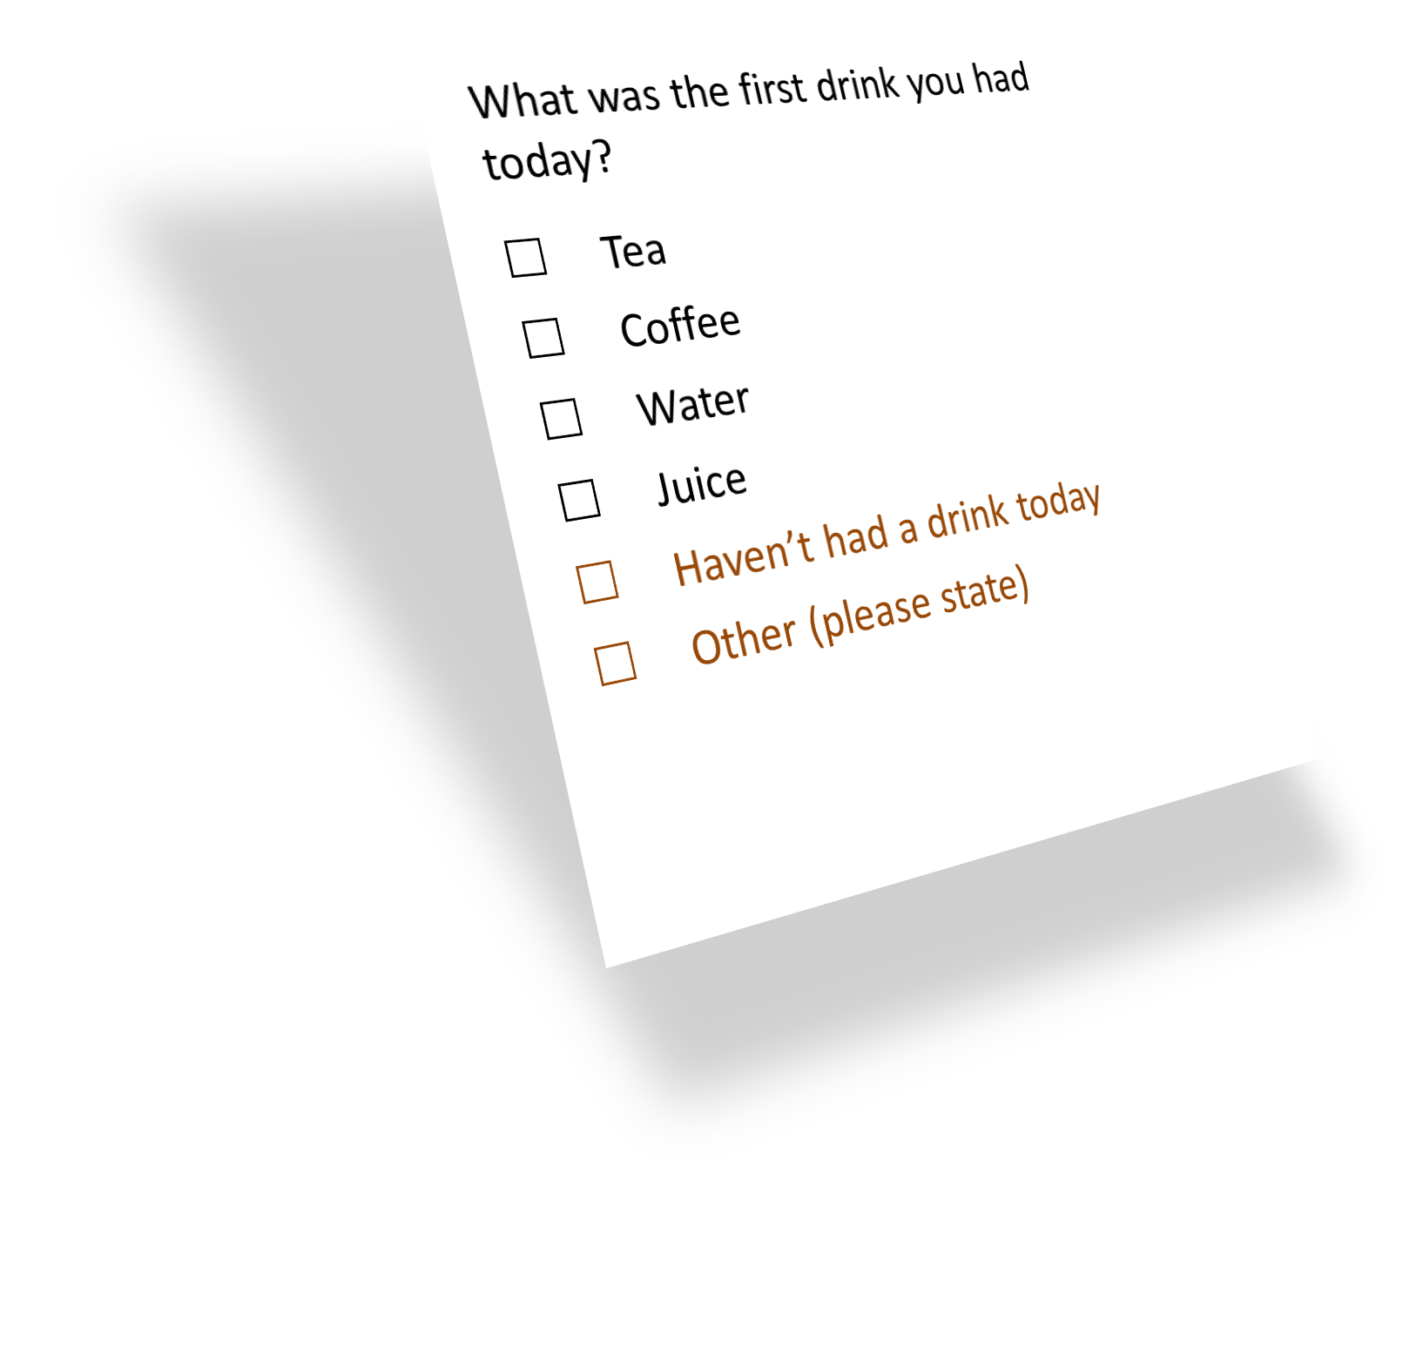
Common mistakes
What might be wrong with this question?
Need to cover all options
Notes:
What might be wrong with this closed question?
When writing closed questions ensure you cover all options or it could bias the analysis. – if unsure whether you have covered everything add an Other option to capture that data.
The answers from closed questions are easier to analyse BUT you are not leaving it open to allow respondents to raise unexpected, or missed, issues. OR to explain their answers.
Other tip for closed questions is :
Research has shown that in self completion questionnaires the first options on a list are chosen most often – whereas in interview situations the latter options are chosen most often.
Additional information
* There is evidence that openin

Slide 40
Unbalanced Scale
A balanced scale has an equal number of positive/ favourable and negative/ unfavourable response choices.
A balanced scale is not as sensitive to differences in opinion when most opinions fall on one side of the issue.
Unbalanced is useful for predominantly one-sided issues and when the degree or magnitude of response is needed.
There is one key point that differs between an unbalanced scale and a balanced scale question. An unbalanced question does not have a mid-point
An unbalanced scale has a larger number of response choices on the side of the scale where the overall attitude of the respondent sample is likely to fall

Slide 41


Balanced and Unbalanced Scales
Fair ever for Men is Fair ever for Men is Extremely good Extremely good Very good Very good Good Good
Bad Somewhat good
Very bad Bad
Extremely bad Very bad
Unbalanced Scale

Slide 42
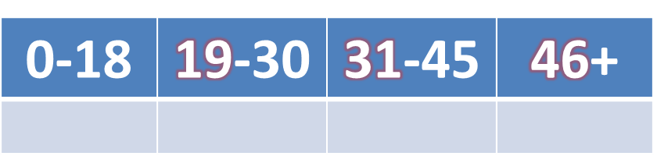
Common mistakes
What might be wrong with this question?
What is your age group?
0-18 | 18-30 | 30-45 | 45+
✗
✓
Options should be mutually exclusive.
Notes:
Sometimes it can be better to appear pedantic than to risk skewing the responses.

Slide 43
Common mistakes
What might be wrong with this question?
What did you think about the waiting time?
Excellent | Very good | Good | Average | Poor
Options should be balanced
‘Good’ responses
‘Bad’ response
Notes:
You’re giving many more good options than poor ones – this is unbalanced.
Number of points used:
Recommend to use either five or seven point scales.
Generally, three-point scales are too narrow to be effective, and there is no evidence that nine points gives greater precision than a seven point scale.
Stick to using the same range of options for all questions where possible.
Or at least for each section
If necessary re-phrase your questions so that they work with the ratings.

Slide 44
Common mistakes
What might be wrong with this question?
How would you rate the appointment booking service using the:
 | Good | Average | Poor
Website
Phone
Reception
N/A
Use opt-out responses appropriately
Notes:
Consider whether an opt out is needed.
Don’t feel qualified
Never considered the subject before
Haven’t used
You need to ensure you are not forcing an answer when an opt out is appropriate. You need to weigh up the options of giving someone an easy way out of not answering a question and a genuine need for an opt out.
Are you asking the question to everyone who booked, will everyone have used all options.
This is fine IF everyone answering has used all of the booking systems, and you’ve chosen your sample on that basis. Respondents tend to try and be useful and answer all questions are even if they haven’t used a service so are likely to use a default response of ‘average’ as their equivalent of an opt out. When you come to analyse the results you will then have no real idea of who found the service ‘Average’ and those who did not actually use the service.
This isn't just for attitude questions it is for any question – even with NICE guidelines there are still often cases where exceptions are allowable. Feel free if you need to get them to justify WHY it’s not applicable – but don’t force, and therefore skew an answer.

Slide 45
Activity I
Industry – Aviation

Slide 46
Activity 2
Industry – Jewelry

Slide 47
Activity 3
Industry – Sports

Slide 48
Activity 4
Industry -Technology

